Slide 1
Lab Assignment
Using Spring Boot

Slide 2
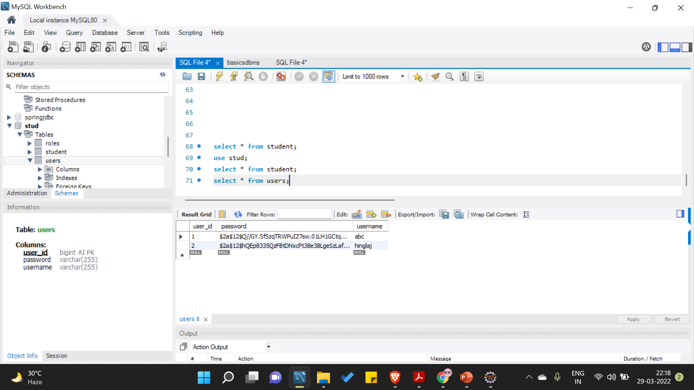
Users Table showing encrypted Password

Slide 3
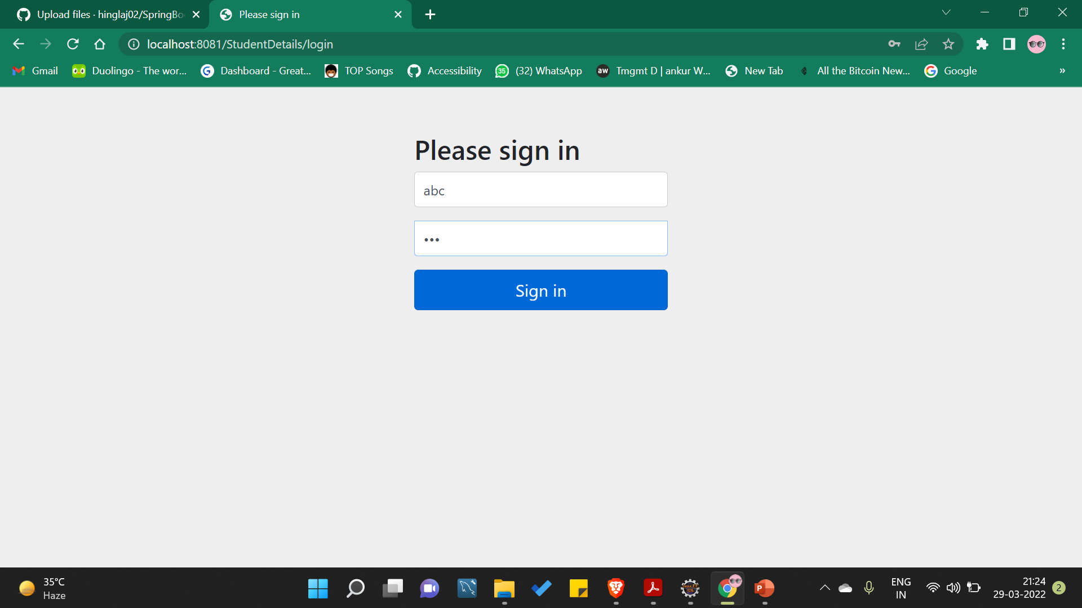
Admin login

Slide 4
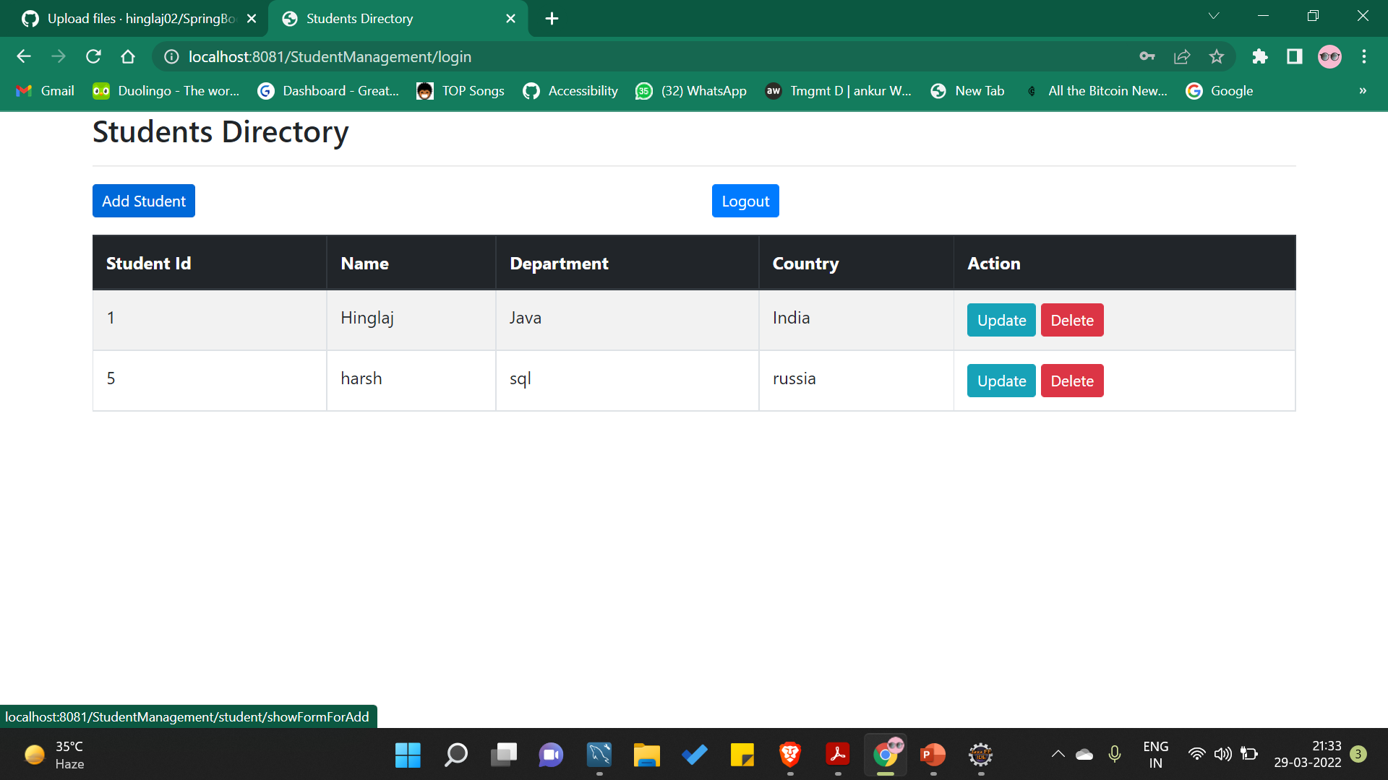
Student List

Slide 5
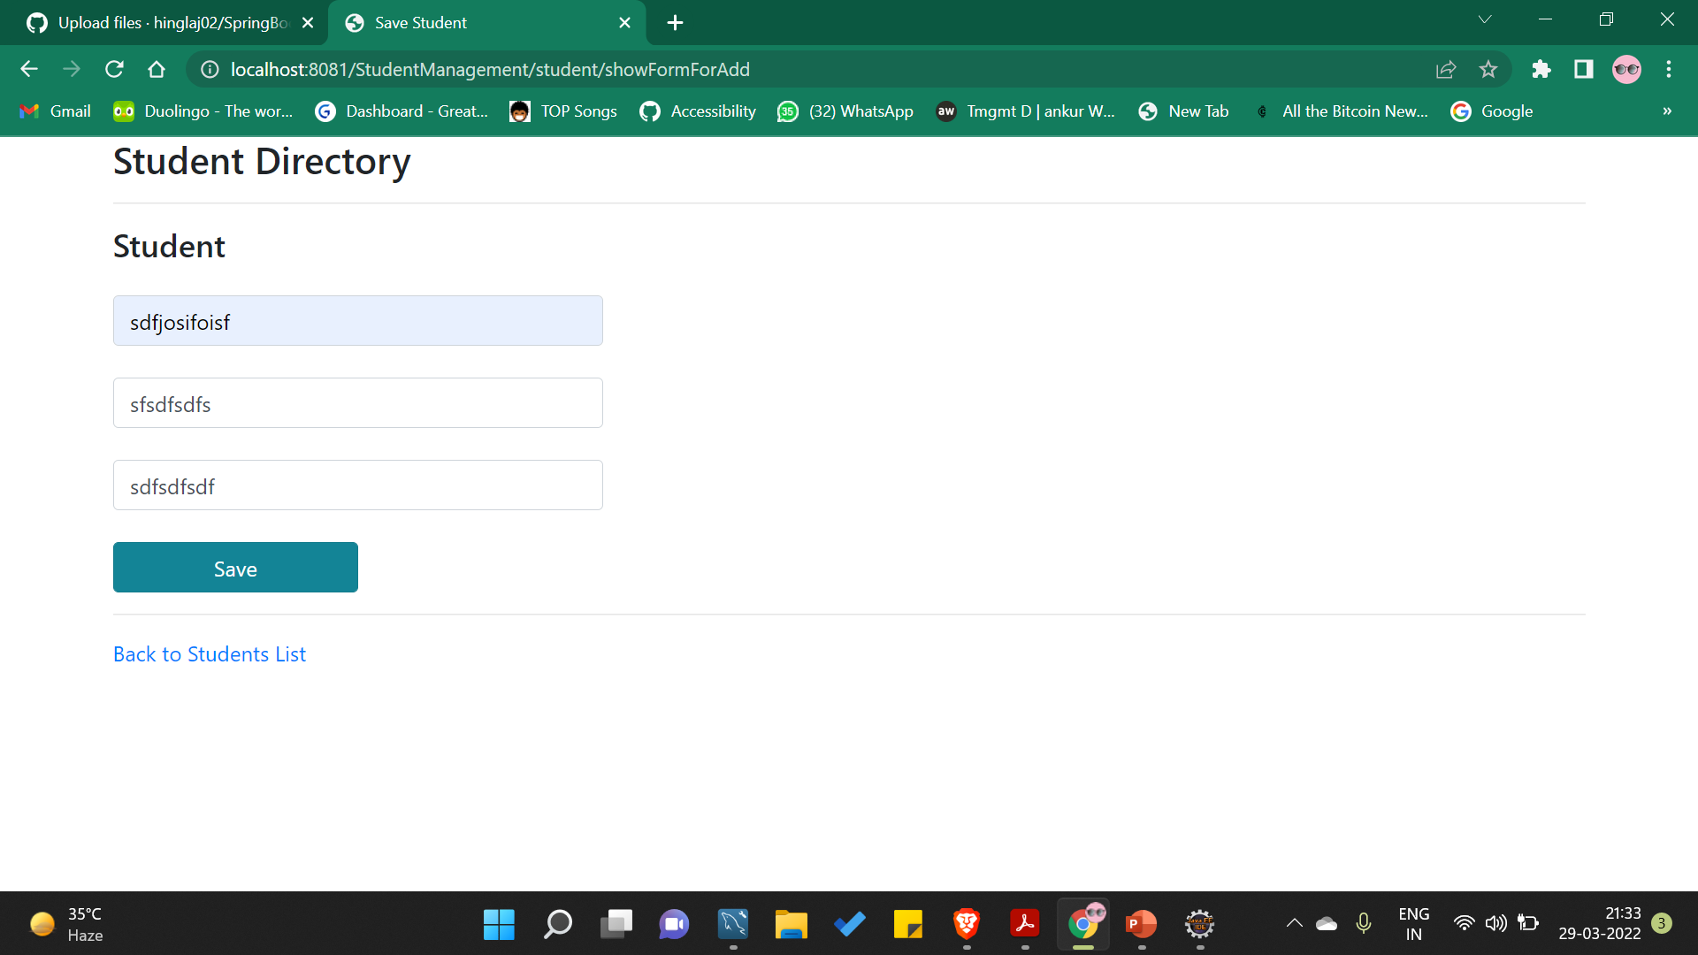
Add Student Form

Slide 6
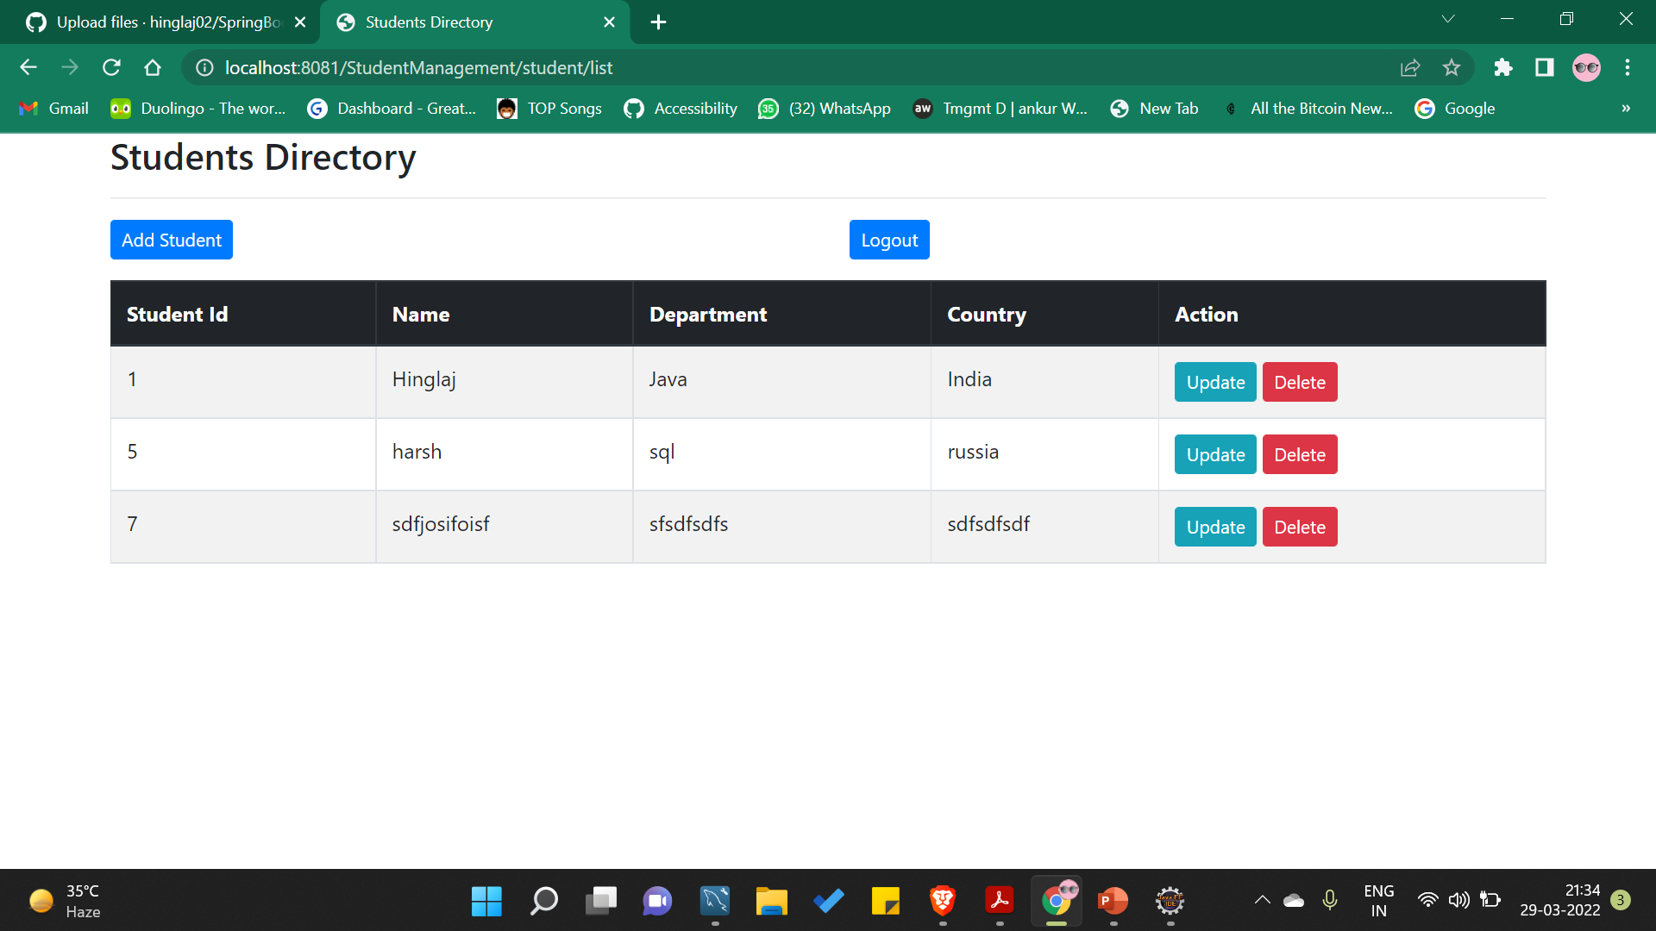
Column Added

Slide 7
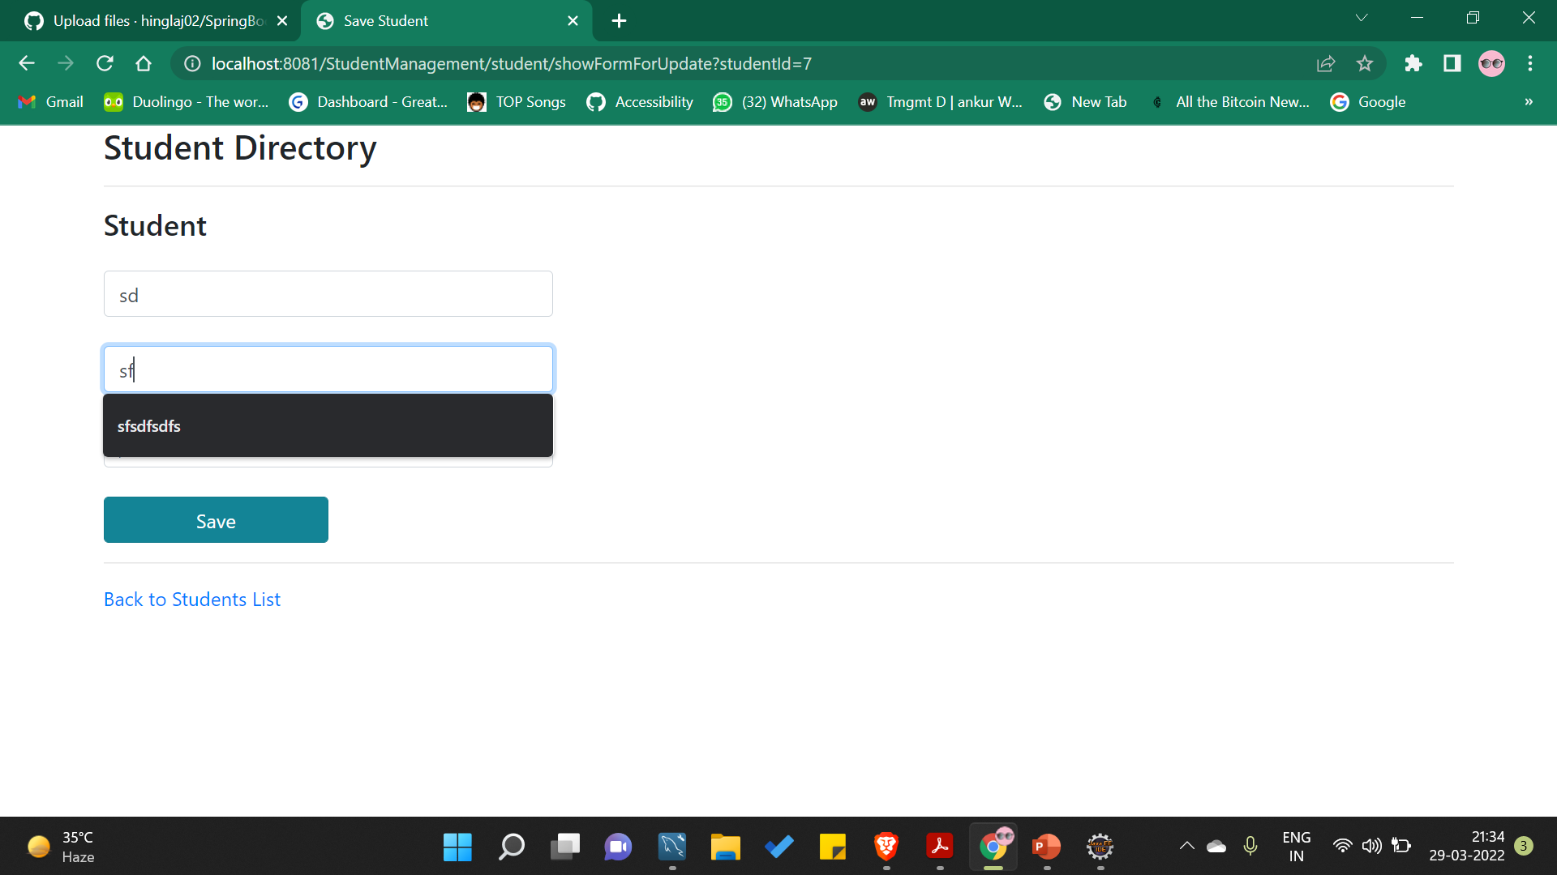
Student Update Form

Slide 8
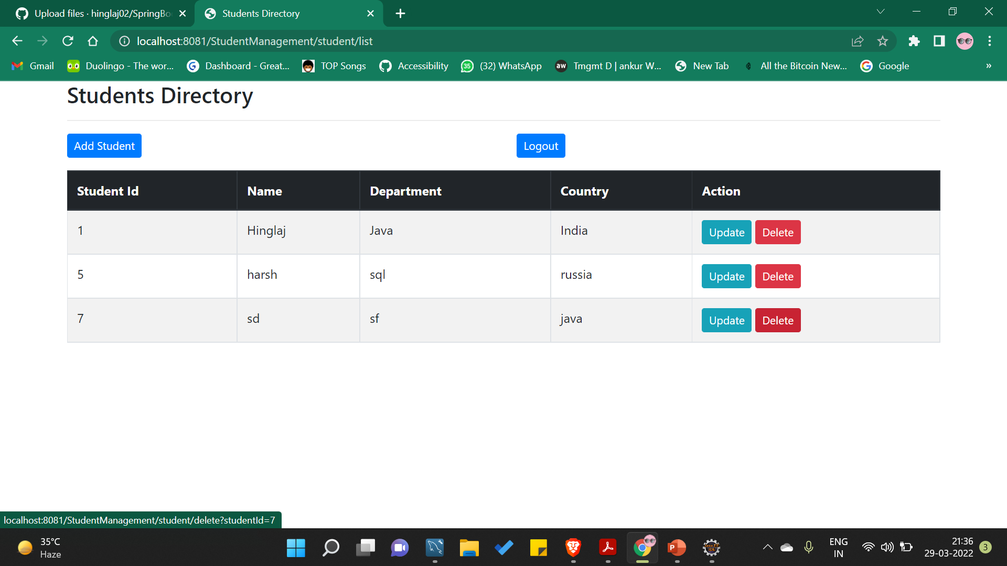
Student Id – 7 Updated

Slide 9
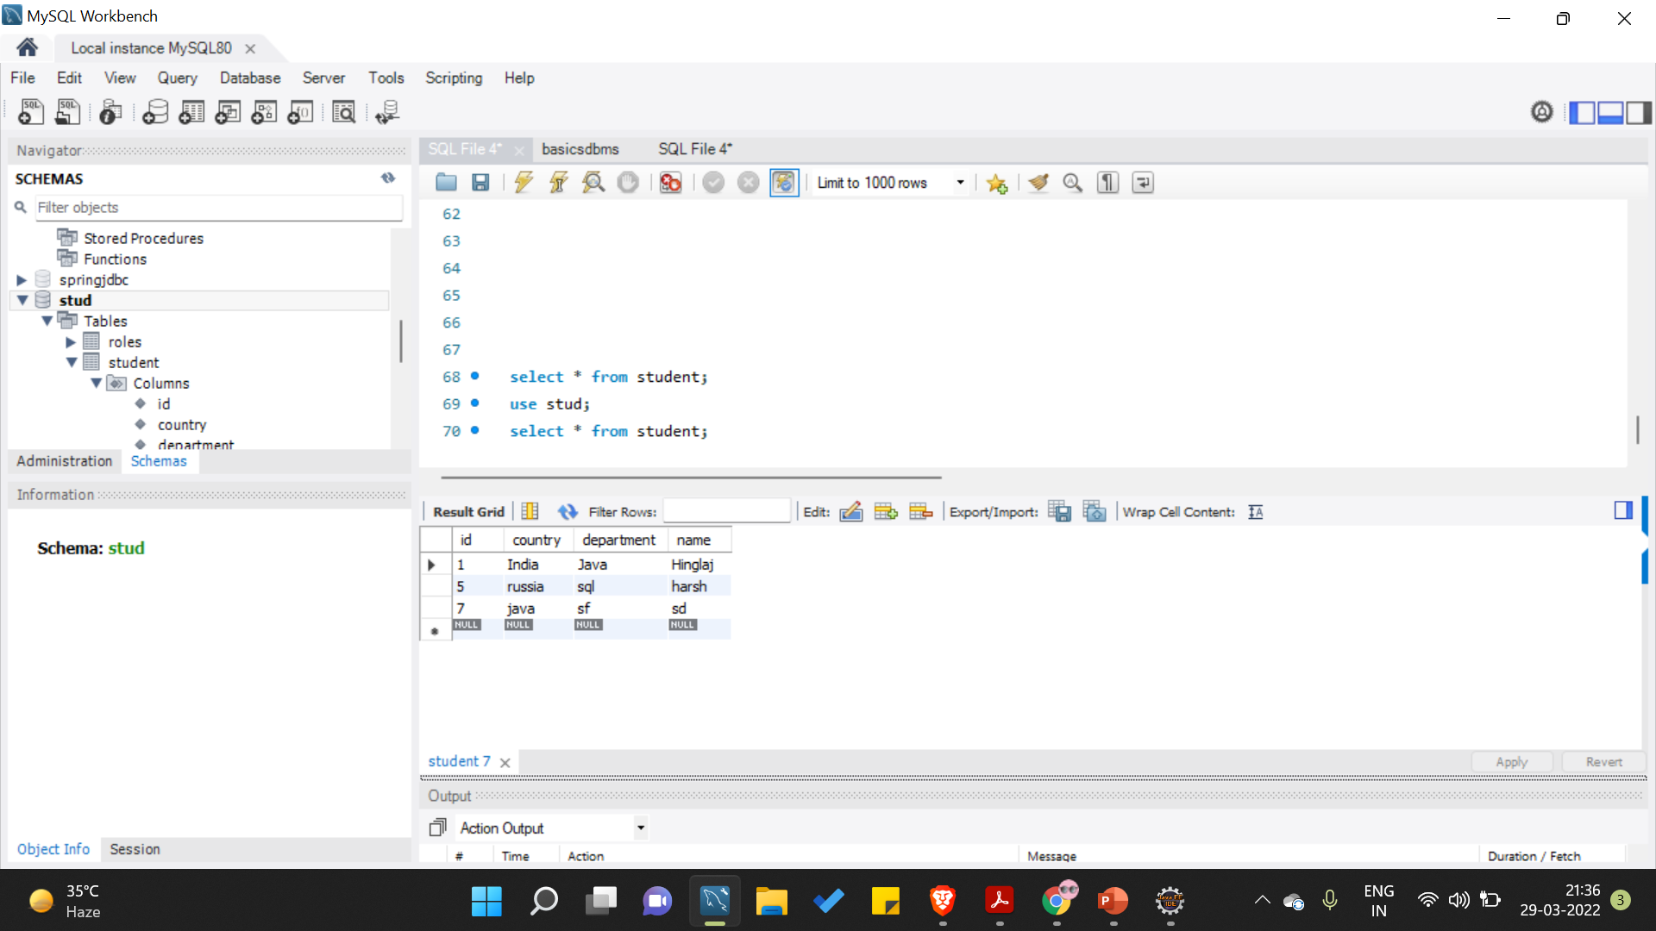
Updated Column in SQL

Slide 10
Delete Column

Slide 11
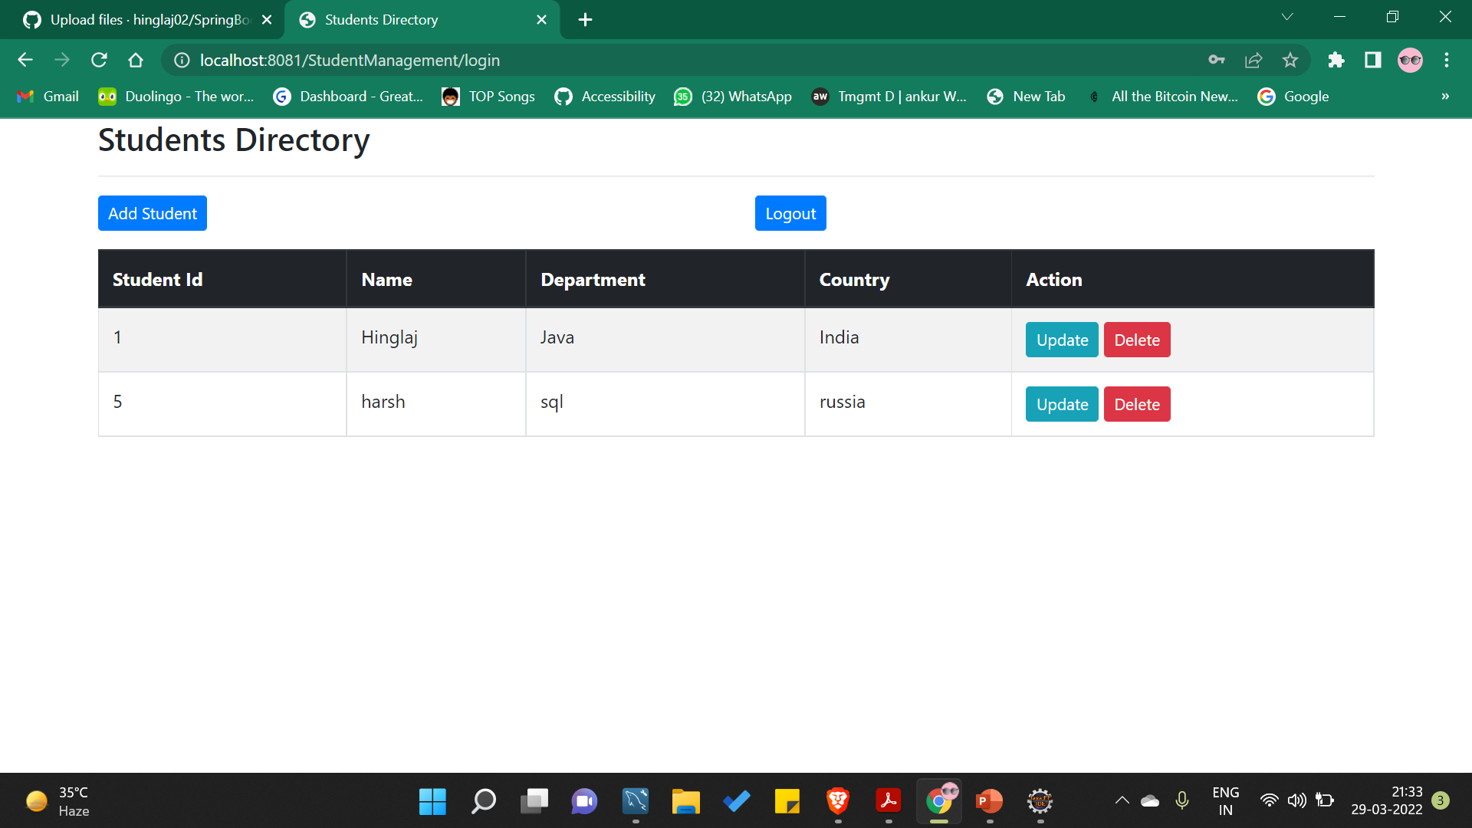
Student Deleted

Slide 12
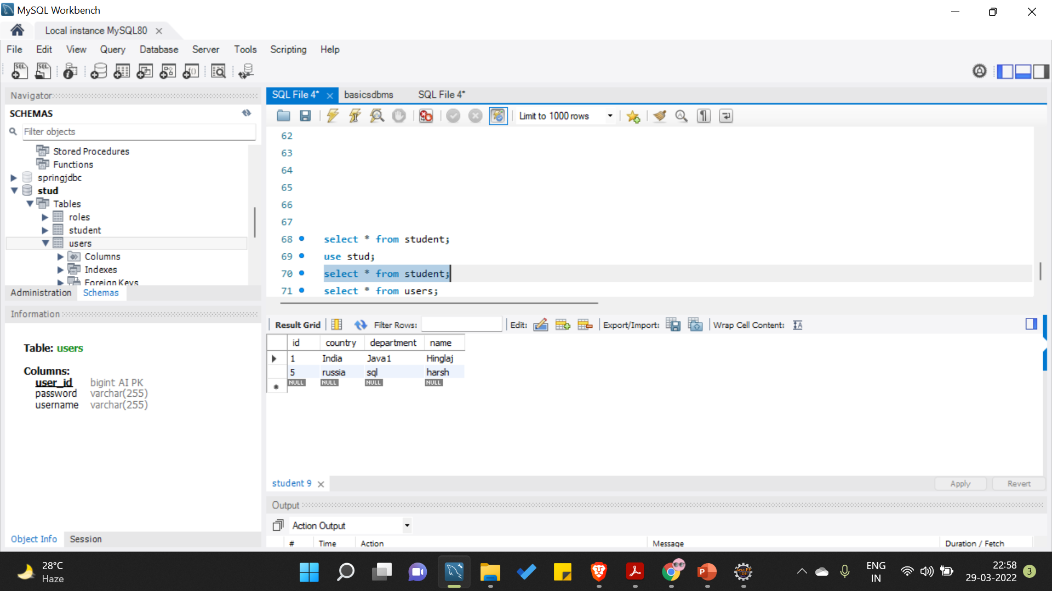
Deleted from SQL

Slide 13
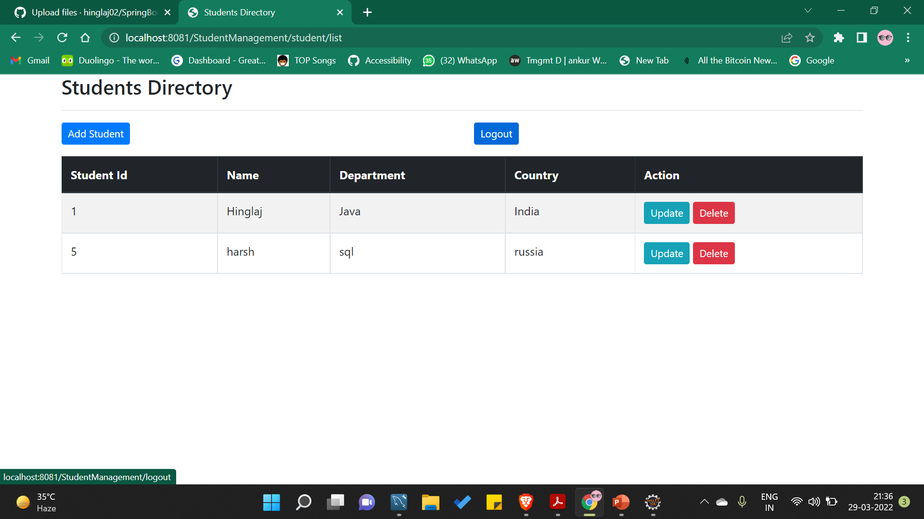
Log Out

Slide 14
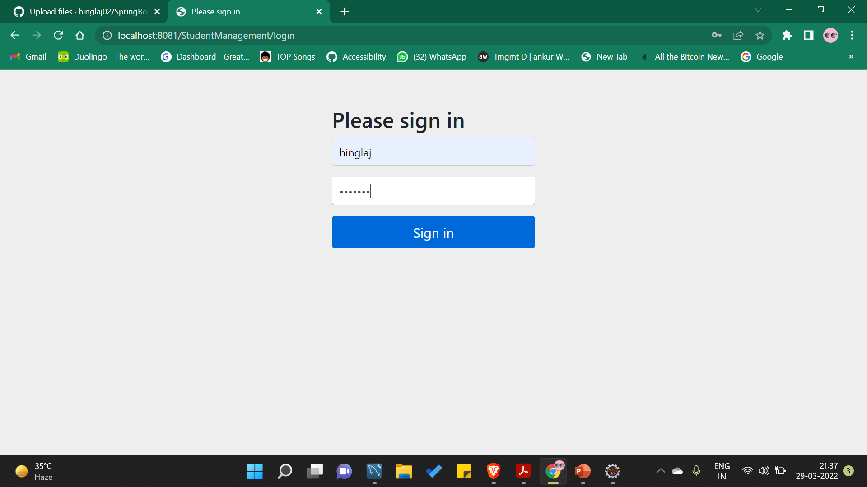
Logging via User Id

Slide 15
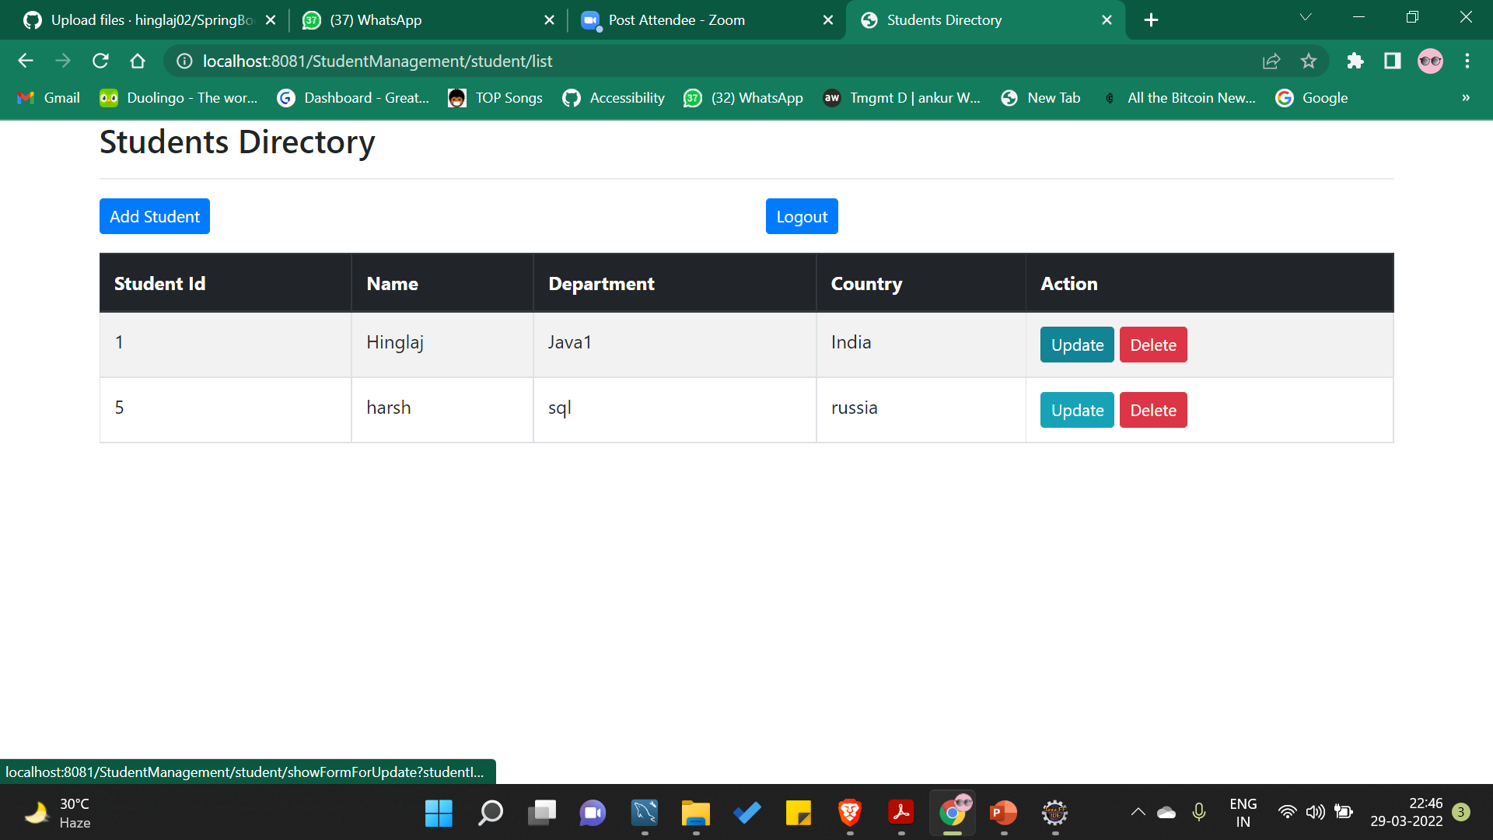
By clicking On Update/Delete Button

Slide 16
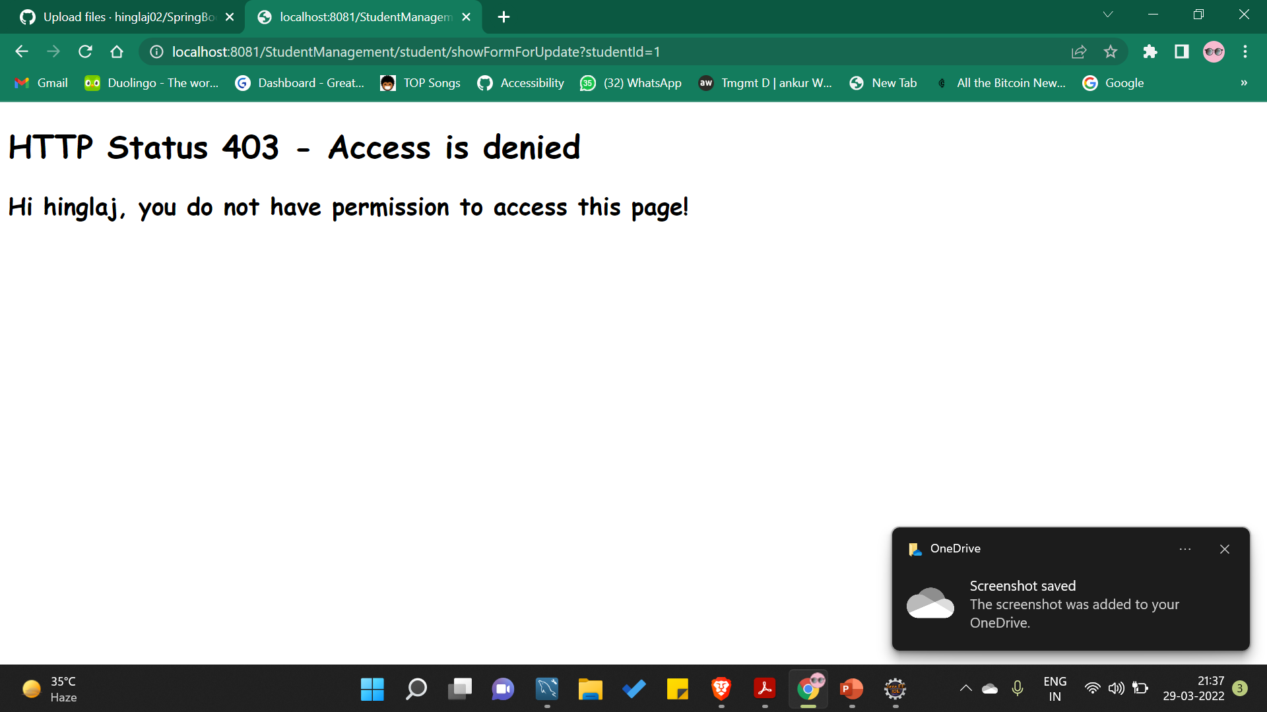

Slide 17
Thank You ☺
Hinglaj Tanwar

